Slide 1
Introduction to Graphs

Slide 2
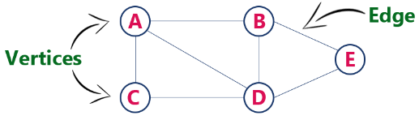
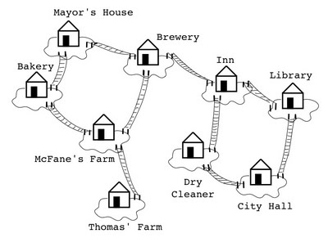
Graph
Graph is a non linear data structure, it contains a set of points known as nodes (or vertices) and set of linkes known as edges (or Arcs) which connets the vertices.
A graph is defined as follows...
  Graph is a collection of vertices and arcs which connects vertices in the graph
  Graph is a collection of nodes and edges which connects nodes in the graph
Generally, a graph G is represented as G = ( V , E ), where V is set of vertices and E is set of edges.
Nodes
Edges

Slide 3
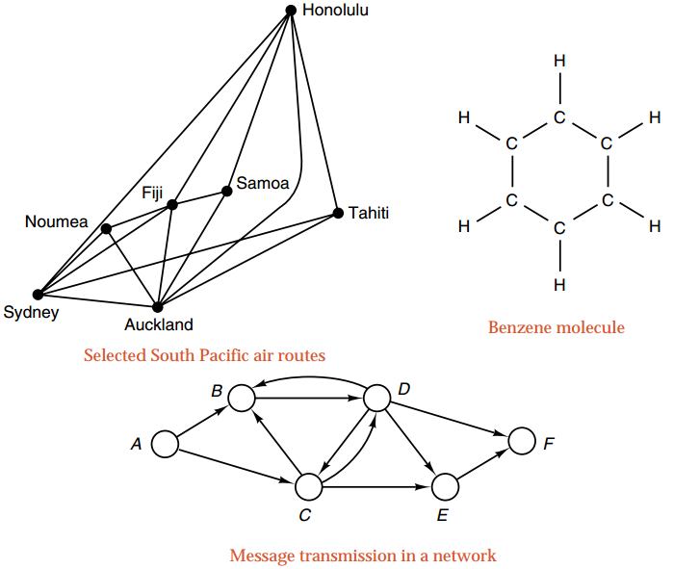
Applications

Slide 4
Graph Terminology
Vertex
A individual data element of a graph is called as Vertex.
Vertex is also known as node.
In above example graph, A, B, C, D & E are known as vertices.
Edge
An edge is a connecting link between two vertices.
Edge is also known as Arc.
An edge is represented as (startingVertex, endingVertex).
For example, in above graph, the link between vertices A and B is represented as (A,B). In above example graph, there are 7 edges (i.e., (A,B), (A,C), (A,D), (B,D), (B,E), (C,D), (D,E)).
Edges are three types,
  Undirected Edge - An undirected egde is a bidirectional edge. If there is a undirected edge between vertices A and B then edge (A , B) is equal to edge (B , A).
  Directed Edge - A directed egde is a unidirectional edge. If there is a directed edge between vertices A and B then edge (A , B) is not equal to edge (B , A).
  Weighted Edge - A weighted egde is an edge with cost on it.

Slide 5
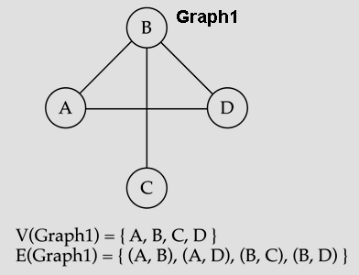
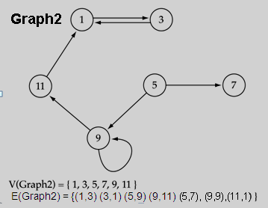
Directed vs. undirected graphs
When the edges in a graph have no direction, the graph is called undirected
When the edges in a graph have a direction, the graph is called directed (or digraph)
Warning: if the graph is directed, the order of the vertices in each edge is important !!

Slide 6
Weighted vs Unweighted graphs
25
32
6
45
12
Weighted Graph
UnWeighted Graph
Weighted Graph → Edges have weight
Unweighted Graph→ Edges have no weight
You may treat unweighted edges to be weighted edges of equal weights

Slide 7

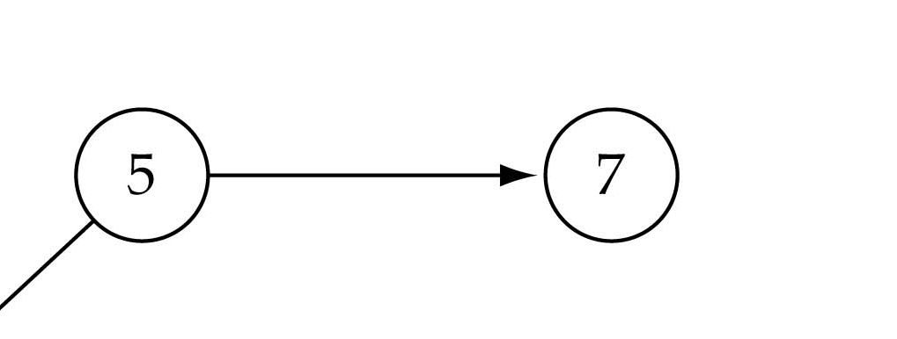
Adjacent and Incident
If (v0, v1) is an edge in an undirected graph,
  v0 and v1 are adjacent
  The edge (v0, v1) is incident on vertices v0 and v1
  (v0, v1) = (v1,v0)
If <v0, v1> is an edge in a directed graph
  v0 is adjacent to v1, and v1 is adjacent from v0
  The edge <v0, v1> is incident on v0 and v1
  <v0, v1> != <v1, v0>
5 is adjacent to 7
7 is adjacent from 5

Slide 8
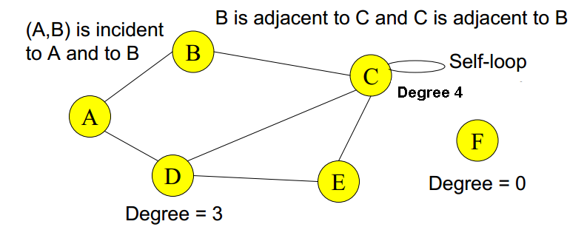
Degree of a Vertex
In undirected graph: Degree of a vertex is the number of edges incident with it

Slide 9

Degree of a Vertex
Directed graph:
Vertex u is adjacent to vertex v in a directed graph G if (u,v) is an edge in G
→ vertex u is the initial vertex of(u,v)
Vertex v is adjacent from vertex u
→ vertex v is the terminal(or end) vertex of(u,v)
Degree
→in-degree is the number of edges with the vertex as the terminal vertex
→out-degree is the number of edges with the vertex as the initial vertex

Slide 10
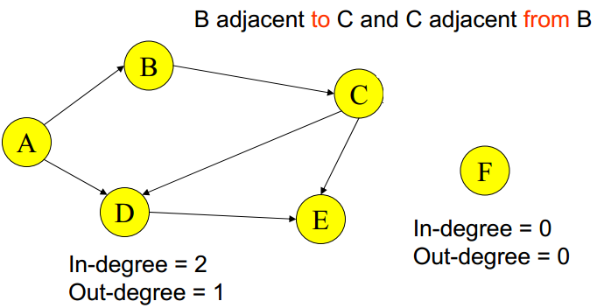

Slide 11
Examples
0
3
2
0
1
2
3
3
3
1
2
3
3
4
5
6
G1
1
1
1
3
G2
1
3
0
in:1, out: 1
1
in: 1, out: 2
in-degree
out-degree
directed graph
2
in: 1, out: 0
G3

Slide 12
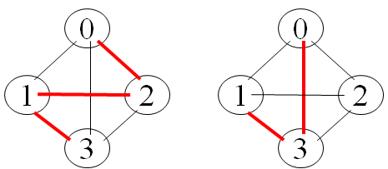
path
  A path from vertex vp to vertex vq in a graph G, is a sequence of vertices, vp, vi1, vi2, ..., vin, vq, such that (vp, vi1), (vi1, vi2), ..., (vin, vq) are edges in an undirected graph.
    A path such as (0, 2), (2, 1), (1, 3) is also written as 0, 2, 1, 3
  The length of a path is the number of edges on it
0
1
2
cycle
3
Simple path
  simple path (simple directed path): a path in which all vertices, except possibly the first and the last, are distinct.
  A cycle is a simple path in which the first and the last vertices are the same.

Slide 13
connected graph: any two vertices are connected by some path
connected
not connected
subgraph: subset of vertices and edges forming a graph
connected component: maximal connected subgraph. E.g., the graph below has 3 connected components.

Slide 14
Subgraphs Examples
0
0
0
1
2
0
1
2
1
2
3
1
2
3
G1
3
(i) (ii) (iii) (iv)
(a) Some of the subgraph of G₁
0
0
0
0
0
1
1
1
1
2
2
2
(i) (ii) (iii) (iv)
(b) Some of the subgraph of G₃
G3

Slide 15
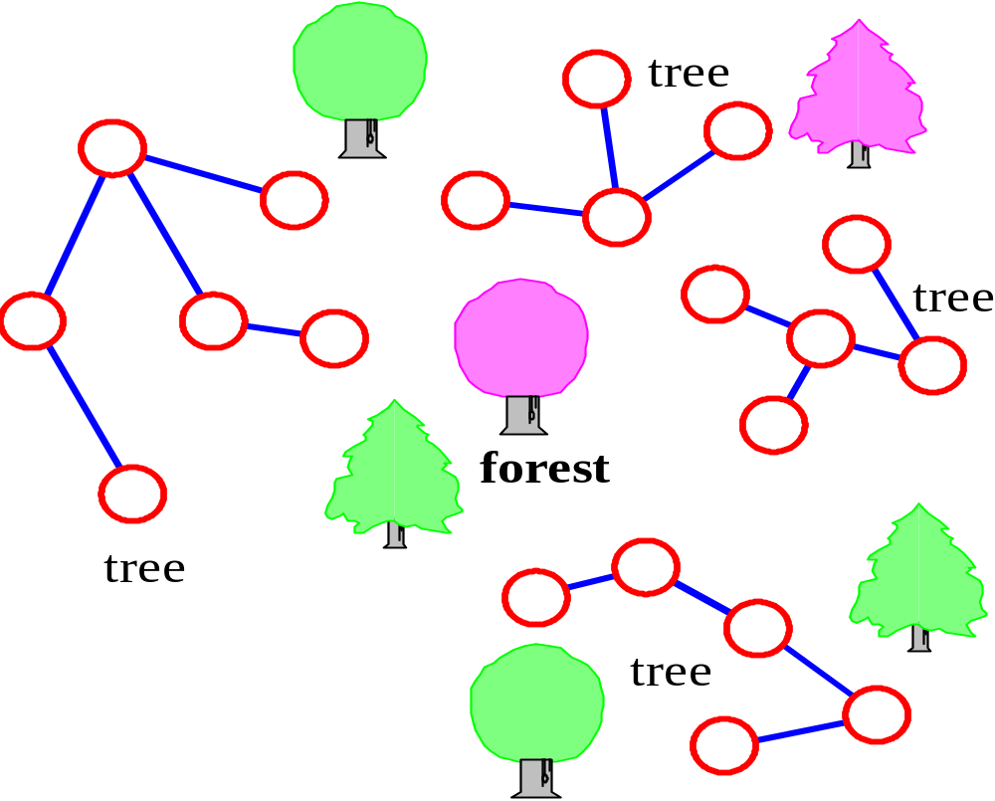
Trees vs graphs
Trees are special cases of graphs!!
Tree → connected graph without cycles
Forest → collection of trees

Slide 16
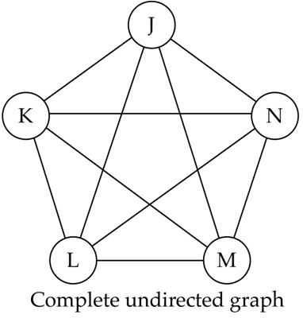
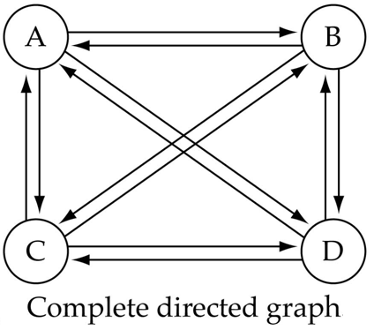
Complete graph
a graph in which every vertex is directly connected to every other vertex
Number of edges in a complete directed graph with N vertices →N * (N-1)
Number of edges in a complete undirected graph with N vertices → N * (N-1) / 2

Slide 17
Graph Representations
Graph data structure is represented using following representations...
  Adjacency Matrix
  Incidence Matrix
  Adjacency List

Slide 18
Adjacency Matrix
In this representation, graph can be represented using a matrix of size total number of vertices by total number of vertices.
That means if a graph with 4 vertices can be represented using a matrix of 4X4 class.
In this matrix, rows and columns both represents vertices.
This matrix is filled with either 1 or 0.
Here, 1 represents there is an edge from row vertex to column vertex and 0 represents there is no edge from row vertex to column vertex.

Slide 19
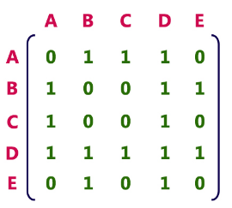
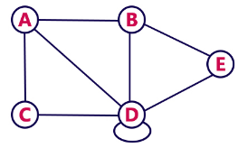
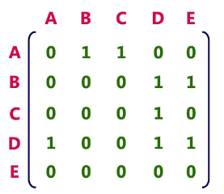
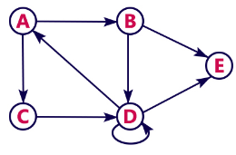
Adjacency Matrix of undirected graph
Adjacency Matrix of directed graph

Slide 20
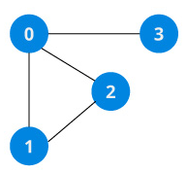
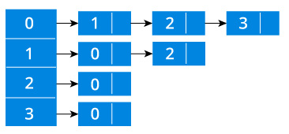
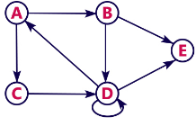
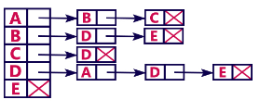
Adjacency List
In this representation, every vertex of graph contains list of its adjacent vertices

Slide 21
Incidence Matrix
In this representation, graph can be represented using a matrix of size total number of vertices by total number of edges.
That means if a graph with 4 vertices and 6 edges can be represented using a matrix of 4X6 class.
In this matrix, rows represents vertices and columns represents edges. This matrix is filled with either 0 or 1 or -1.
Here, 0 represents row edge is not connected to column vertex, 1 represents row edge is connected as outgoing edge to column vertex and -1 represents row edge is connected as incoming edge to column vertex.

Slide 22
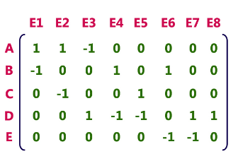
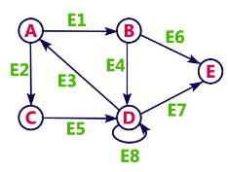
Incidence Matrix

